Slide 1
Using R to incorporate data science into the undergraduate statistics curriculum
eRum Lightning Talk
October 14, 2016
Paul Roback
St. Olaf College
Northfield, Minnesota, USA

Slide 2
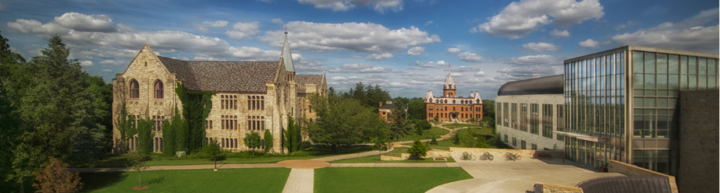
St. Olaf College
liberal arts college of 3000 undergraduates
intensely residential
global engagement
Norwegian Lutheran heritage
music, medicine, mathematics

Slide 3
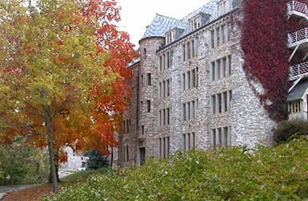
Department of Mathematics, Statistics, and Computer Science
Big Tent philosophy
80 math majors, 20 computer science majors, and 30 statistics concentrators per class
Top 10 among all US institutions for PhDs in the mathematical sciences

Slide 4
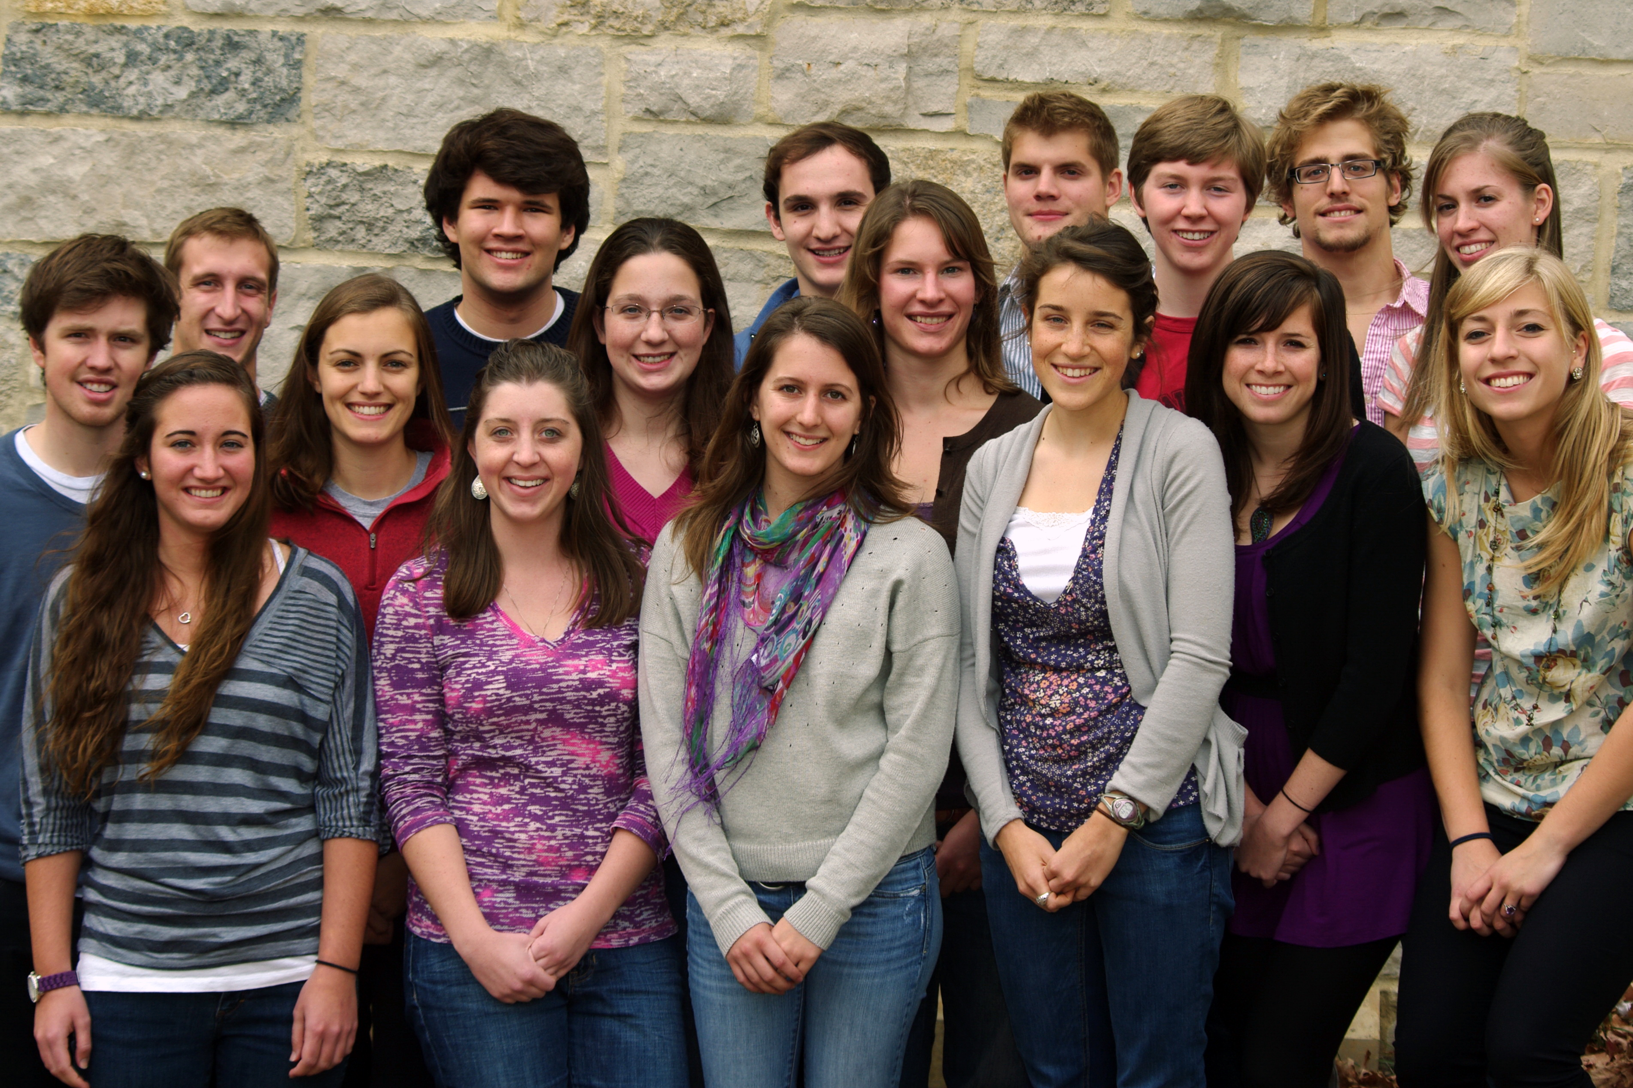
Statistics Concentration - minimum 4 courses
Core
Statistical Modeling (linear and logistic regression)
Advanced Statistical Modeling (GLMs and multilevel models)
Electives
Mathematical
Prob Theory, Stat Theory
Computational
Intro to CS with R, Algorithms for Decision Making, Data Viz
Applied
Econometrics, Biostats, Social Science Methods, Research Methods in Psych or Sociology
Experiential Component (recommended)
Center for Interdisciplinary Research (CIR), Mathematics Practicum

Slide 5
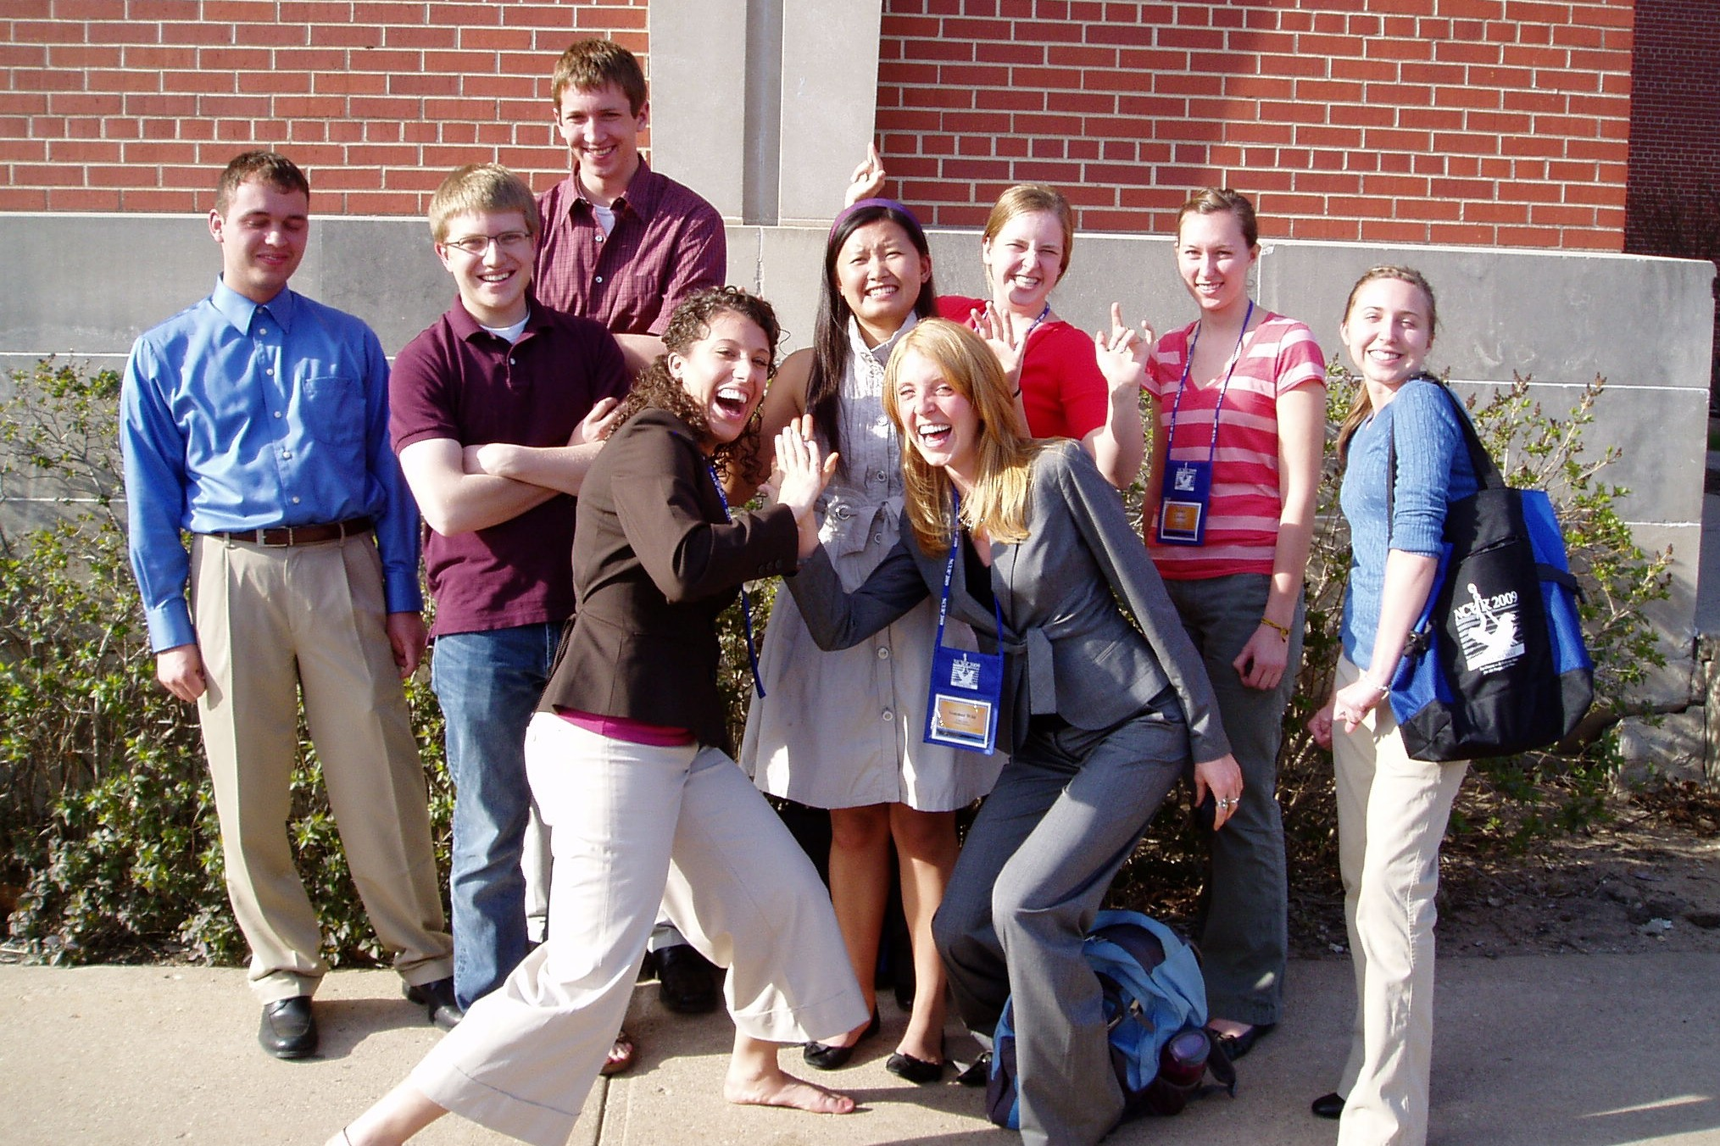
Statistical innovations at St. Olaf
one of first liberal arts colleges in US to add statistics concentration (1977)
inverted curriculum
undergraduate research experience and training as collaborators
Advanced Modeling curriculum
modernize Math Stat with Bayes and computing
intro stats with R and simulation-based methods
"data-infused" intro to CS with R and Python

Slide 6
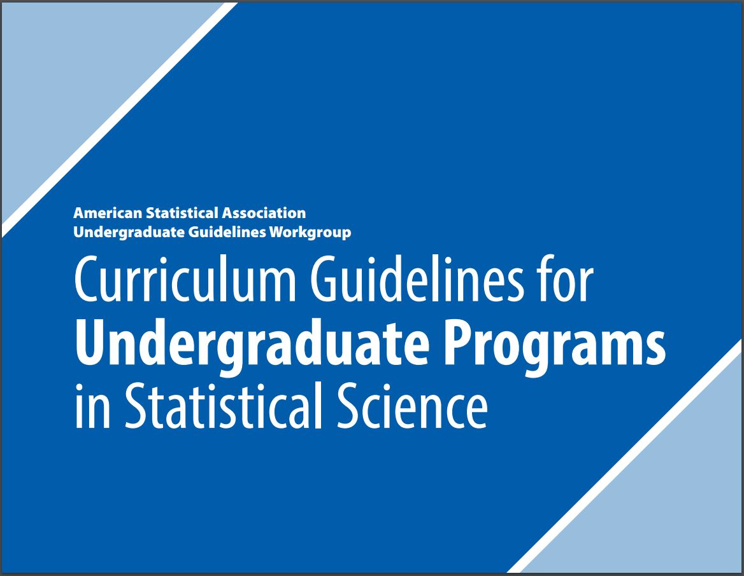
New challenge: "Increased importance of data science"

Slide 7

Addressing data science
Modules in existing courses
Recently-developed electives
Potential new required course: Intro to Data Science
New concentration or major?
New faculty with new skill sets

Slide 8
Addressing data science
Modules in existing courses
Tidy data; ggplot; MCMC; R Markdown
Recently-developed electives
Potential new required course: Intro to Data Science
New concentration or major?
New faculty with new skill sets

Slide 9
Addressing data science
Modules in existing courses
Recently-developed electives
Data-infused Intro to Computer Science
Algorithms for Decision Making (ISLR)
Data Visualization
Potential new required course: Intro to Data Science
New concentration or major?
New faculty with new skill sets

Slide 10
Addressing data science
Modules in existing courses
Recently-developed electives
Potential new required course: Intro to Data Science
Prerequisites?
Topics? Data viz; data transformation; EDA; data wrangling; programming; modeling; communication...
Textbook? Use R for Data Science by Grolemund and Wickham? Other?
New concentration or major?
New faculty with new skill sets

Slide 11
Addressing data science
Modules in existing courses
Recently-developed electives
Potential new required course: Intro to Data Science
New concentration or major?
Current concentration + good advising serves wide variety of needs
Would have to be thoughtful, cohesive curriculum, not a hastily-assembled, buzzword-filled, "pick from several buckets" program
New faculty with new skill sets

Slide 12
Addressing data science
Modules in existing courses
Recently-developed electives
Potential new required course: Intro to Data Science
New concentration or major?
New faculty with new skill sets
Or... "teach old dogs new tricks"

Slide 13
Addressing data science: Guiding question
What grounding coursework and experiences will allow our graduates continued growth over their careers in a data-filled world rather than merely a ticket to their first job or graduate school acceptance?

Slide 14
I would love to chat further if you have ideas or experiences to share!
Paul Roback
Professor of Statistics
St. Olaf College
roback@stolaf.edu

